Slide 1

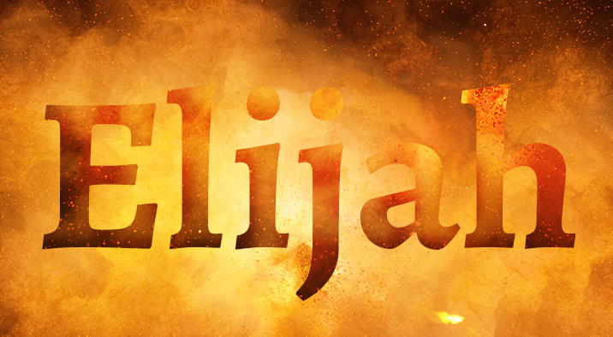
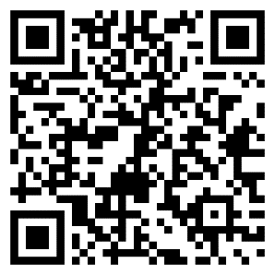
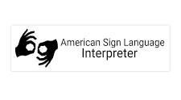
The Valley’s premier community choir
www.northvalleychorale.org
Experience the fiery majesty of
Mendelssohn’s “crowning achievement” – Elijah!
Featuring over 60 singers with live orchestra, ASL interpreter and the new organ at one of the Valley's top concert venues!
Eleanor Johnson, Artistic Director
ONE PERFORMANCE ONLY!
Camelback Bible Church
3900 E. Stanford Dr.
Paradise Valley, AZ 85253
Sunday, April 28, 2024, at 3:00 PM
For tickets, $25 & $28, scan the QR code
OR visit www.northvalleychorale.org
OR call box office 623.252.1748

